Slide 1
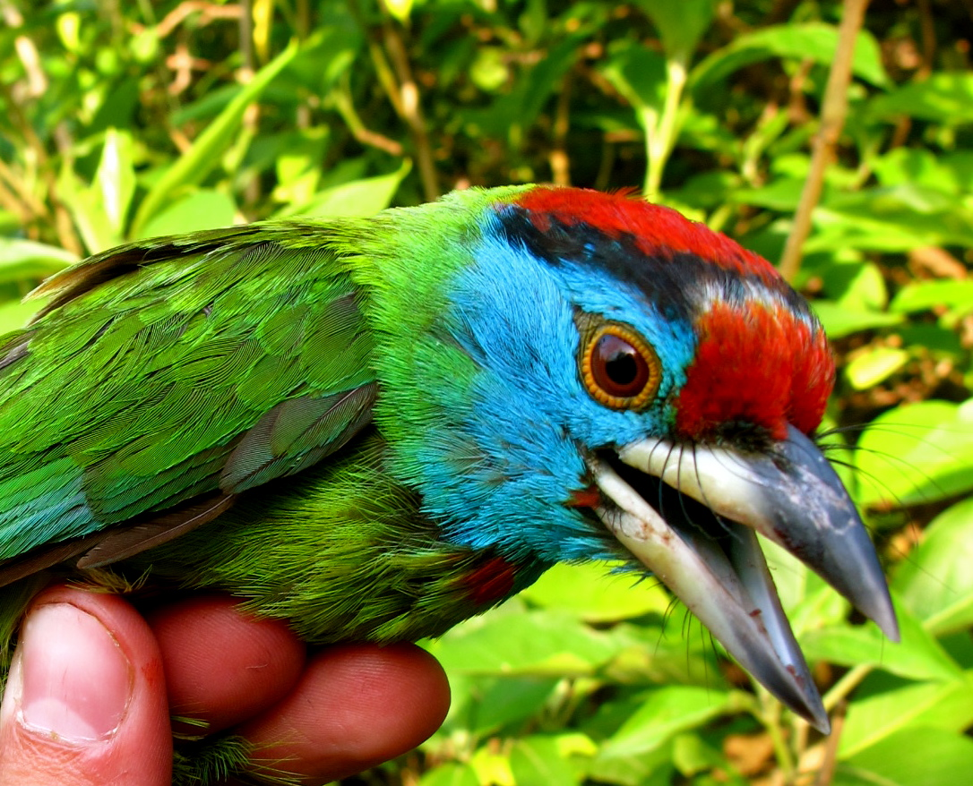
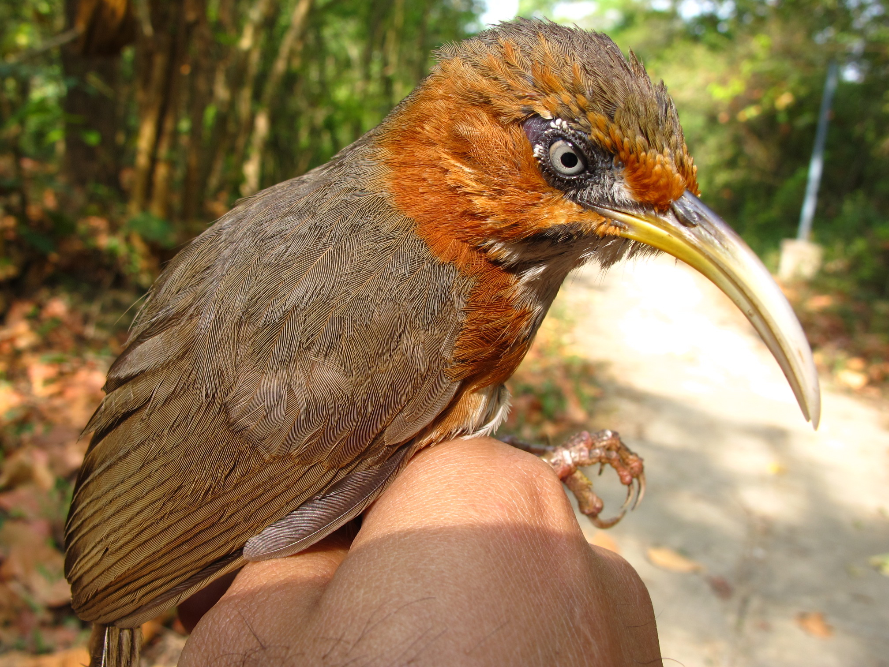
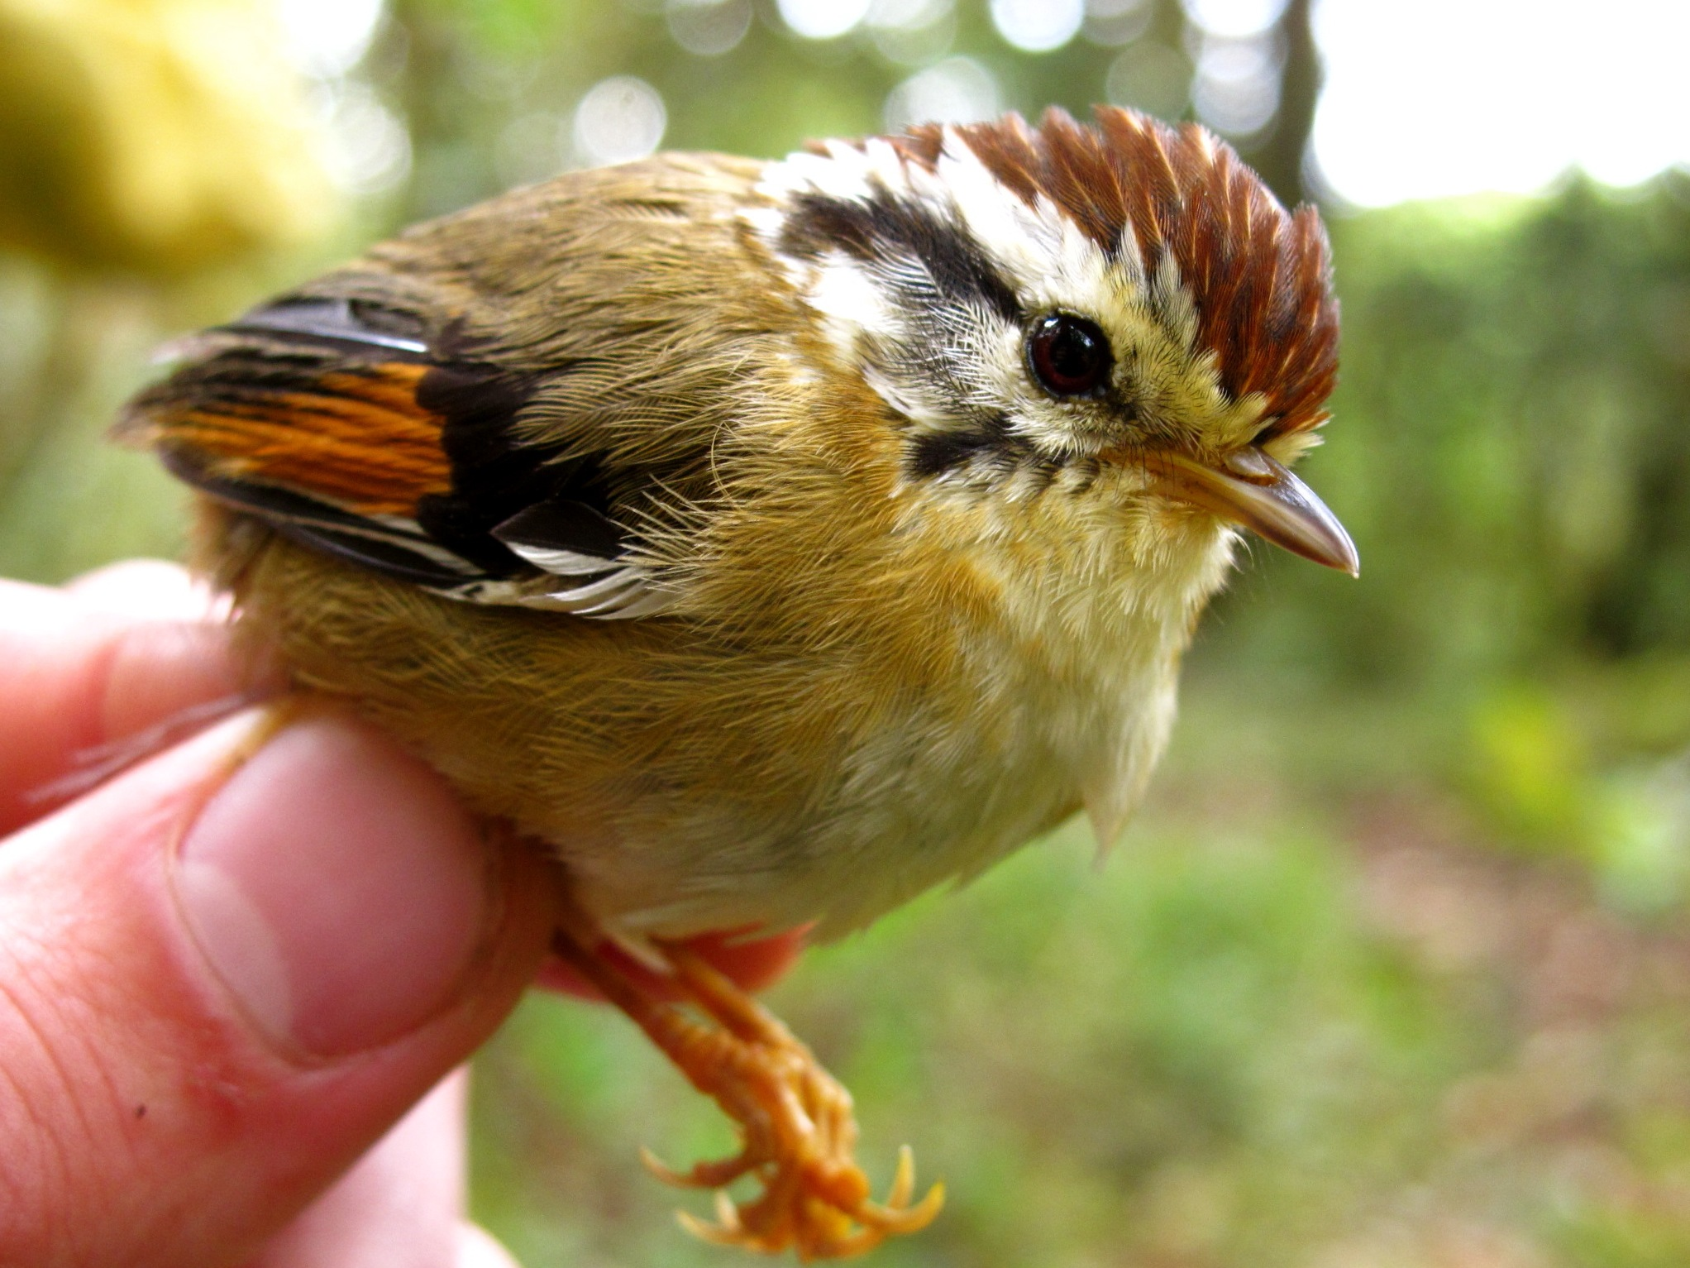
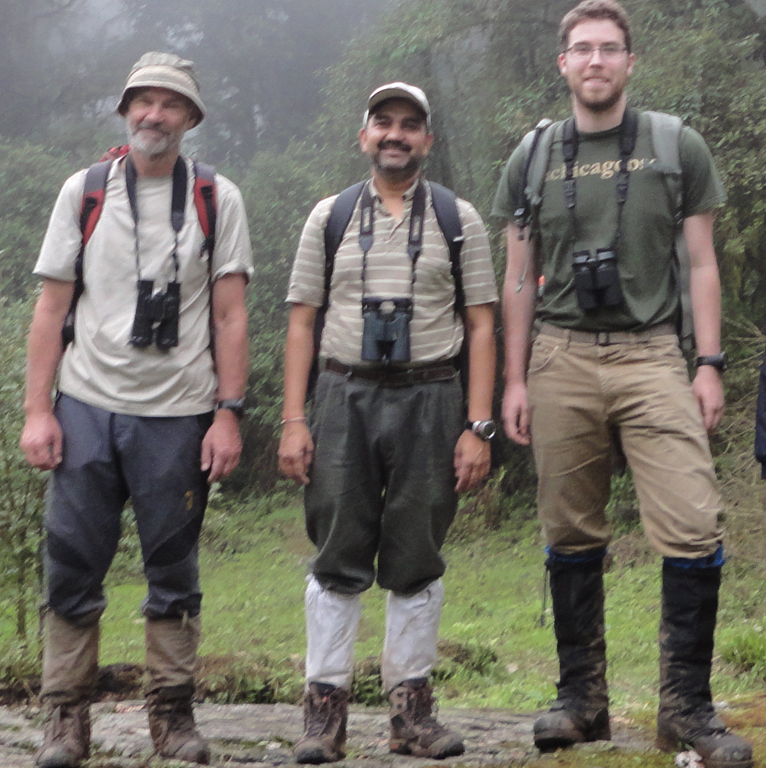

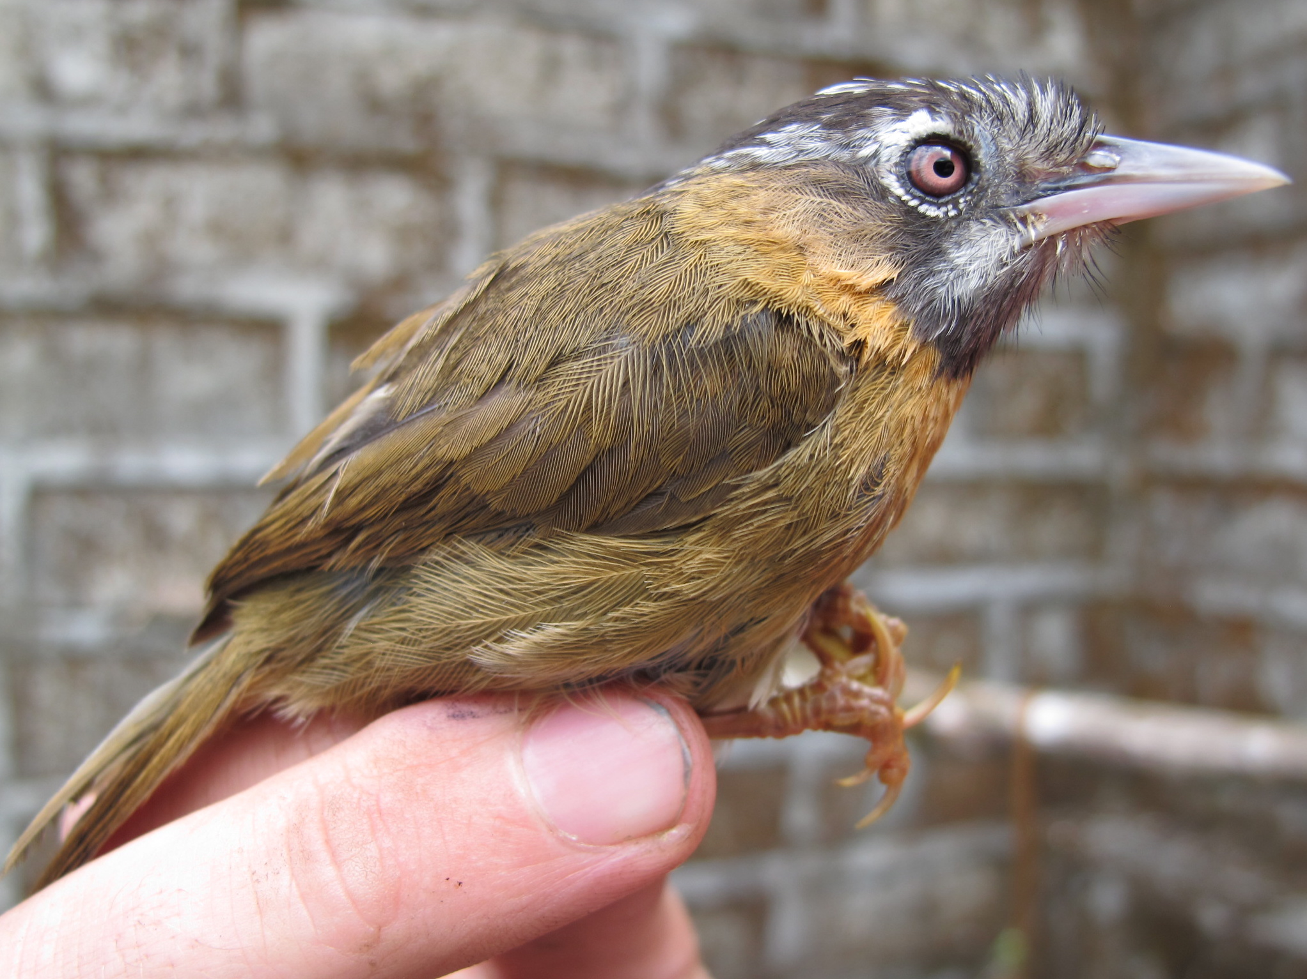
Assembly of the Himalayan Avifauna
Alex White
Trevor Price
Dhananjai Mohan
Kushal Dey
Stephens Lab, Statistics

Slide 2
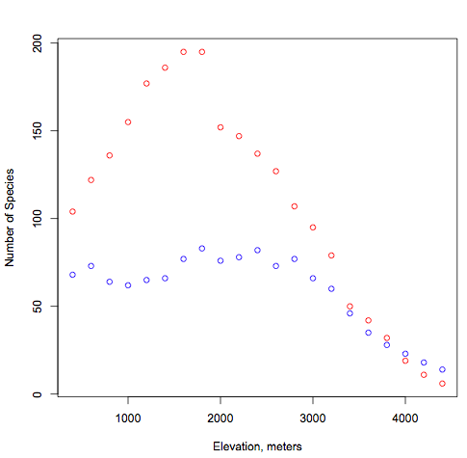
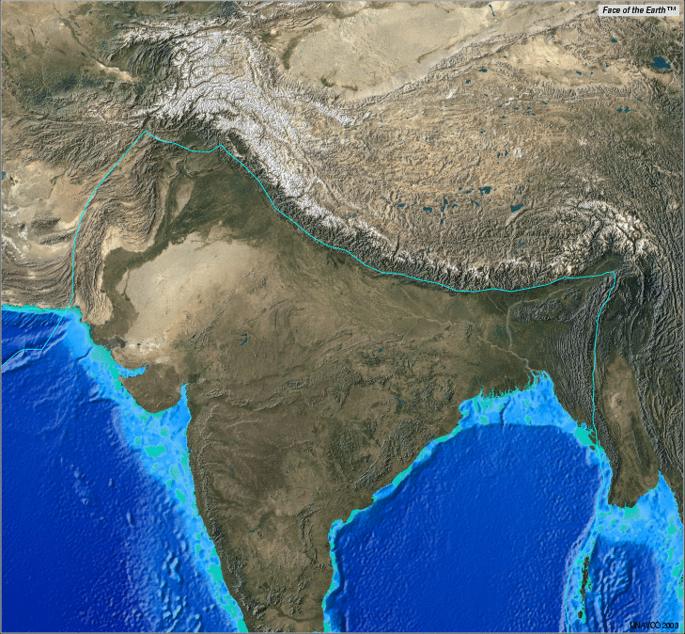
East
West
Number of bird species
Elevation (m)

Slide 3
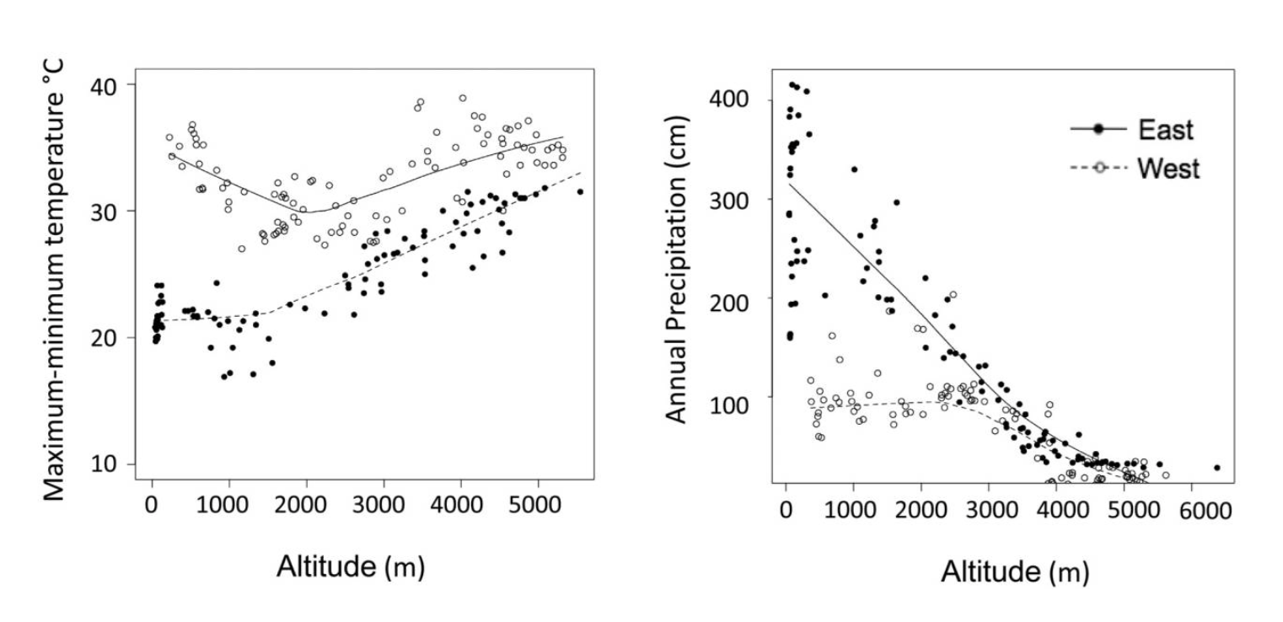
East
West
Number of bird species
Elevation (m)
Elevation (m)
Elevation (m)

Slide 5
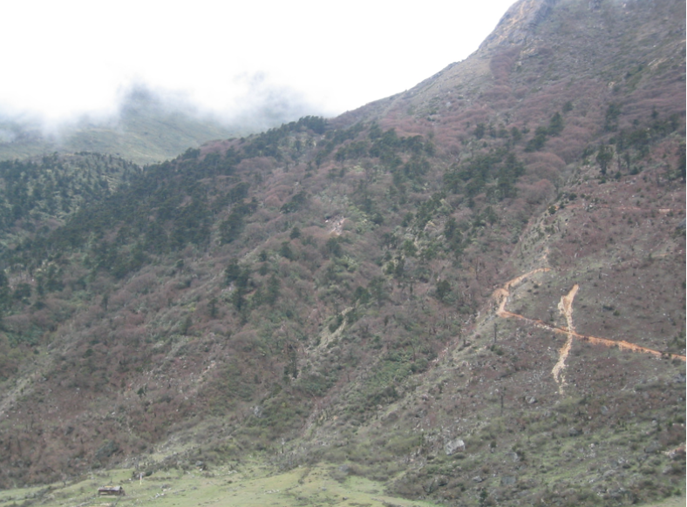

Slide 6
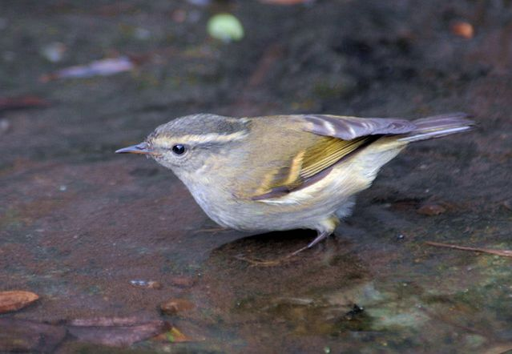
N = 11 species
David Blank
Notes:
buff barred warbler

Slide 7
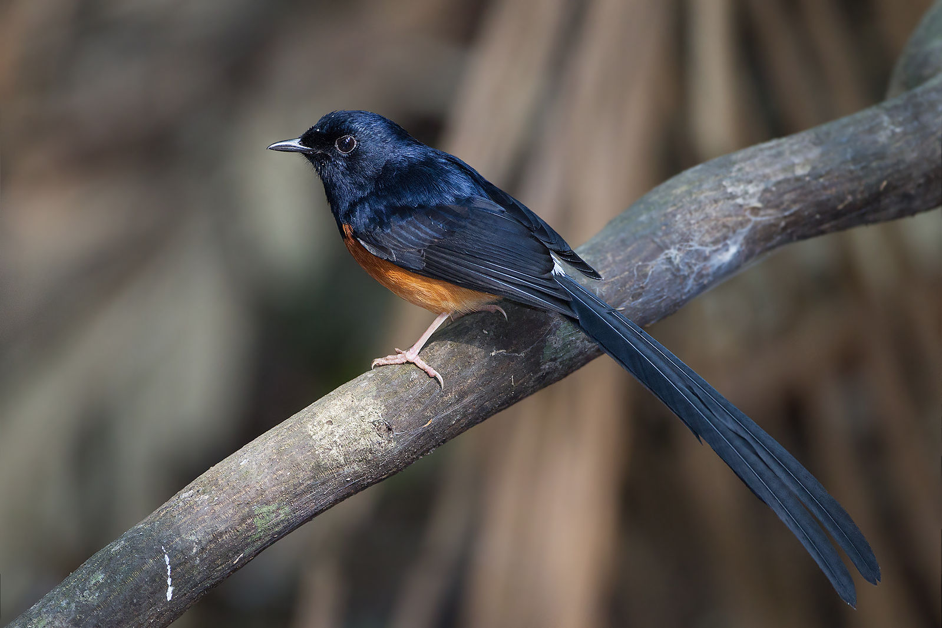
N = 34 species
JJ Harrison
Notes:
shama

Slide 8
Forest patches are connected through shared species
4200 m
Elevation
200 m

Slide 9
Elevation (m)

Slide 13
Passerines
Passerines
Non Passerines
Non Passerines

Slide 15
“Assemblage dispersion fields”
Graves and Rahbek 2005

Slide 16
Why does the “transition” move up
from 1500m to 3000m in the West,
but remain at 1500 in the East?

Slide 17
Why does the “transition” move up
from 1500m to 3000m in the West,
but remain at 1500 in the East?

Slide 18
Why does the “transition” move up
from 1500m to 3000m in the West,
but remain at 1500 in the East?
4

Slide 20
Why does the “transition” move down
from 3000m to 1500m in the West,
but remain at 1500 in the East?

Slide 21
Why does the “transition” move down
from 3000m to 1500m in the West,
but remain at 1500 in the East?

Slide 22
Why does the “transition” move down
from 3000m to 1500m in the West,
but remain at 1500 in the East?
Very abundant species in both
the east and west.
Phylloscopus chloronotus
Phylloscopus reguloides
Phylloscopus xanthoschistos
Parus monitcolus

Slide 23
Why does the “transition” move down
from 3000m to 1500m in the West,
but remain at 1500 in the East?
K = 3 when accounting for mass
Log(mass * abundance)

